Slide 1
AI Plays Pokemon Red
Rahaan Gandhi, Aashay Kadakia, Ishant Kundra

Slide 2
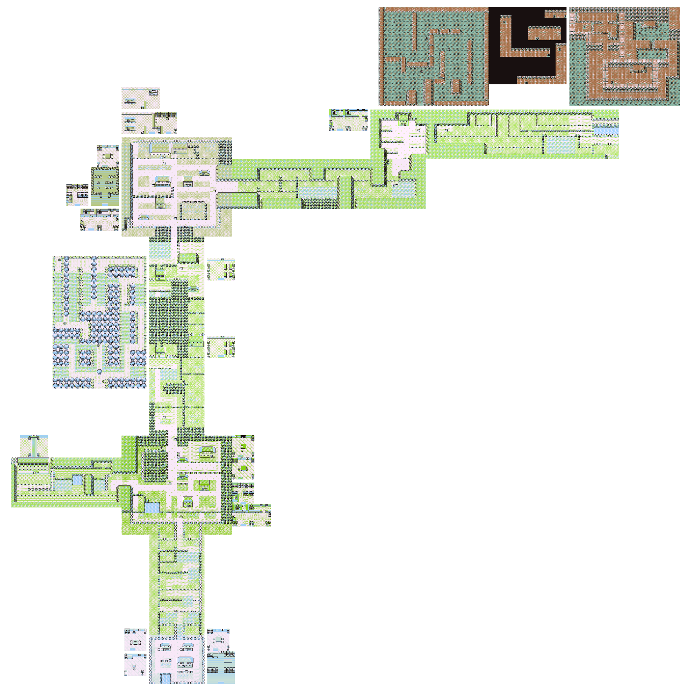
Introduction: Pokemon Red
Overview: The paper focuses on enhancing exploration in reinforcement learning (RL) agents playing Pokémon Red, by modifying the reward function to encourage curiosity-driven exploration.
Goal: To encourage the RL agent to explore the Pokémon Red map beyond just progressing through the main objectives of the game.
Key Challenge: Traditional RL agents mainly focus on task completion. We aim to create an agent that values exploration of the environment itself.

Slide 3

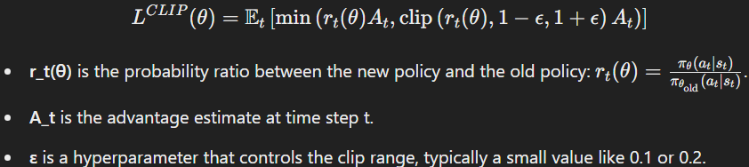
How Reinforcement Learning Works in Gaming
Key Points:
Markov Decision Processes (MDPs) framework.
Importance of reward structures in RL.
Algorithms used: Q-Learning and PPO.
PPO
Q-learning

Slide 4
Modifying Reward Functions
Original Reward: The baseline reward function incentivized typical game objectives like defeating opponents and collecting badges.
Rtotal = Revent + Rbadge + Rhealth + Rlevel
Curiosity-driven Reward: Adds rewards for exploring new areas of the map and penalties for staying stagnant in one place for too long.
Rtotal_curiosity = Revent + Rbadge + Rhealth + Rlevel + Rexplore + Rstagnant
Custom Reward: Further adjusted for better exploration and handling obstacles like healing or getting stuck in battles. Custom weights for curiosity and penalties for excessive healing or failures in battles.

Slide 5
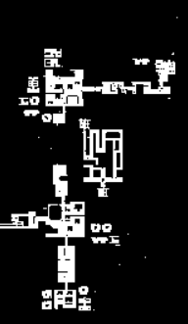
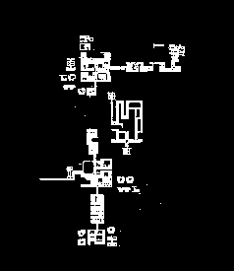
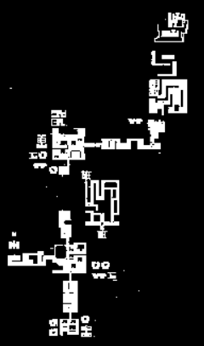
Map exploration Progress after 320 steps for Original, curiosity, custom
Original
Curiosity
Custom

Slide 6
Results and Analysis
Map Exploration:
After 64 iterations: Most explored: Curiosity, Custom, then Original
After 192 iterations: The three functions explored around the same percentage
After 320 iterations: Custom pulled ahead, while curiosity and original stayed similar
Performance Comparison:
The Custom function led to better map coverage and more strategic behavior (higher levels and fewer unnecessary actions like excessive healing).

Slide 7
Conclusion
Custom weights led to more deaths but better map coverage.
Curiosity-driven function improved exploration but lacked refinement.
RL in DL is challenging but rewarding.
Positive and negative reinforcement are critical tools.
Video games provide rich testbeds for RL experimentation.
Broader implications: Applications in robotics, autonomous systems, and beyond.

Slide 8

Video Demo

